Slide 1
Design Patterns

Slide 2


Gang of Four

Slide 3
Creational Structural Behavioral
ایجاد کننده ساختاری رفتاری

Slide 4
Creational Design Patterns:
Singleton Pattern
Category: Creational
Description: Ensures that a class has only one instance and provides a global point of access to that instance.
Factory Method Pattern
Category: Creational
Description: Defines an interface for creating an object but allows subclasses to alter the type of objects that will be created.
Abstract Factory Pattern
Category: Creational
Description: Provides an interface for creating families of related or dependent objects without specifying their concrete classes.
Builder Pattern
Category: Creational
Description: Separates the construction of a complex object from its representation, allowing the same construction process to create various representations.
Prototype Pattern
Category: Creational
Description: Creates new objects by copying an existing object, known as the prototype.

Slide 5
Structural Design Patterns:
Adapter Pattern
Category: Structural
Description: Allows the interface of an existing class to be used as another interface, making it compatible with the client's requirements.
Decorator Pattern
Category: Structural
Description: Attaches additional responsibilities to an object dynamically, providing a flexible alternative to subclassing for extending functionality.
Composite Pattern
Category: Structural
Description: Composes objects into tree structures to represent part-whole hierarchies, allowing clients to treat individual objects and compositions of objects uniformly.
Proxy Pattern
Category: Structural
Description: Provides a surrogate or placeholder for another object to control access to it.

Slide 6
Behavioral Design Patterns:
Observer Pattern
Category: Behavioral
Description: Defines a one-to-many dependency between objects, so that when one object changes state, all its dependents are notified and updated automatically.
Strategy Pattern
Category: Behavioral
Description: Defines a family of algorithms, encapsulates each one, and makes them interchangeable. It lets the algorithm vary independently from clients that use it.
Command Pattern
Category: Behavioral
Description: Encapsulates a request as an object, thereby allowing for parameterization of clients with queues, requests, and operations.
State Pattern
Category: Behavioral
Description: Allows an object to alter its behavior when its internal state changes. The object will appear to change its class.
Memento Pattern
Category: Behavioral
Description: Captures and externalizes an object's internal state so that the object can be restored to this state later.

Slide 7
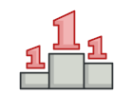
Singleton in Python

Slide 8
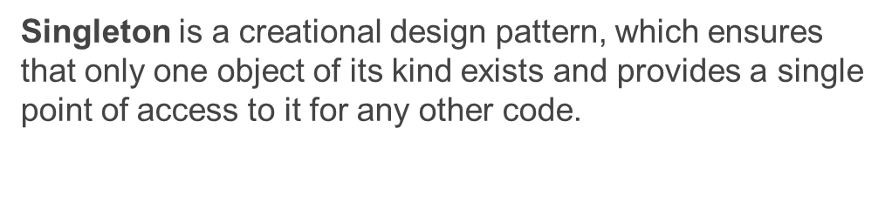

Slide 9
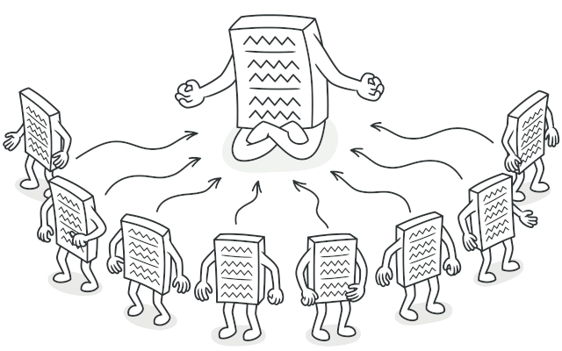
Singleton is a creational design pattern that lets you ensure that a class has only one instance, while providing a global access point to this instance.

Slide 10
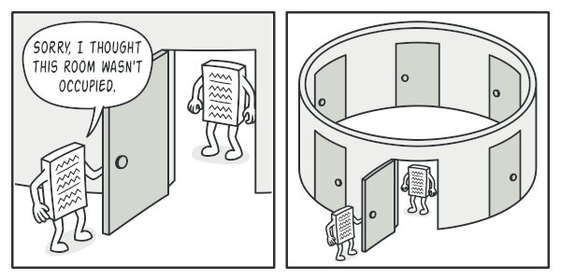
چه نیازی داریم؟

Slide 11
SHARED RESOURCES DATABASE

Slide 12
SHARED RESOURCES DATABASE

Slide 13
یک کلاس فقط یک نمونه خواهد داشت
فرض کنید که یک شی درست کرده‌اید و میخواهید مجدد همان شی را ایجاد کند، در حالت عادی این کار ممکن نیست.
نقطه اتصال global ایجاد خواهد شد
همه یک شی خواهند دید و استفاده خواهند کرد و البته از تغییر آن جلوگیری و بطور کلی از نمونه محافظت می‌شود.

Slide 14
singleton
کاری که عموما انجام می‌شود
Make the default constructor private, to prevent other objects from using the new operator with the Singleton class.
Create a static creation method that acts as a constructor. Under the hood, this method calls the private constructor to create an object and saves it in a static field. All following calls to this method return the cached object

